Slide 1
Animal Ordering in ACAP©
Created by
Isaac P. E. Mailleue
Research Integrity Coordinator
University of North Carolina at Greensboro
September 2013

Slide 2
ACAP developers and the ORI recommend you use Internet Explorer when using ACAP.
Some bugs have been much more likely to occur with other browsers.
We also recommend you always click buttons instead of hitting the “Enter” key.
Again, some bugs seem more frequent if you hit the “Enter” key

Slide 3
NOTE: Consultation with the Operations Manager regarding space allocation is recommended prior to submission of application.
IACUC approval of application does not assure Vivarium space availability. Please contact Vivarium for pre-study strategy meeting prior to ordering animals to discuss availability of housing.

Slide 4
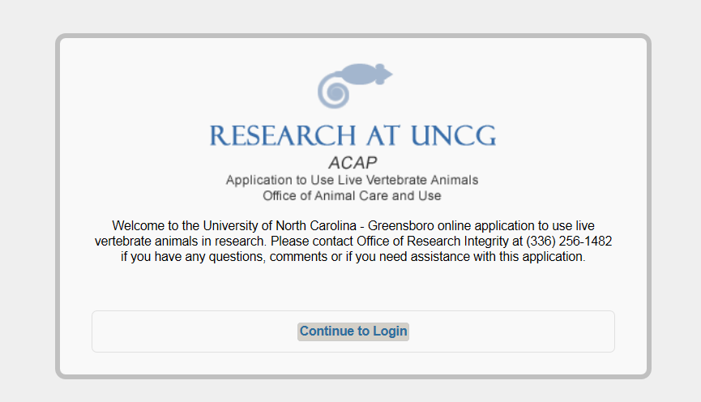
Go to: https://uncg.myresearchonline.org/acap/index_auth.cfm

Slide 5
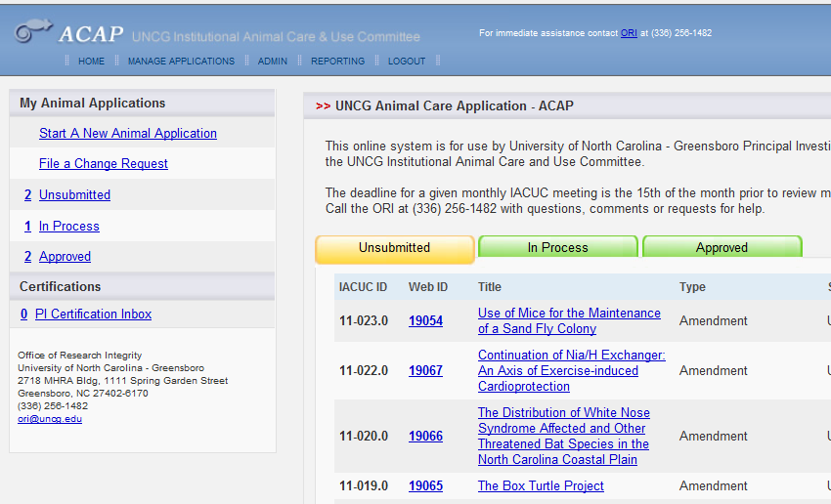
Select the study you want to order animals for by clicking on “Approved”

Slide 6
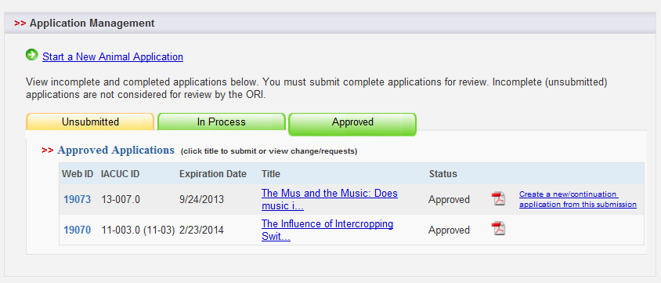
Now click on the title for the study you want to order animals for.

Slide 7
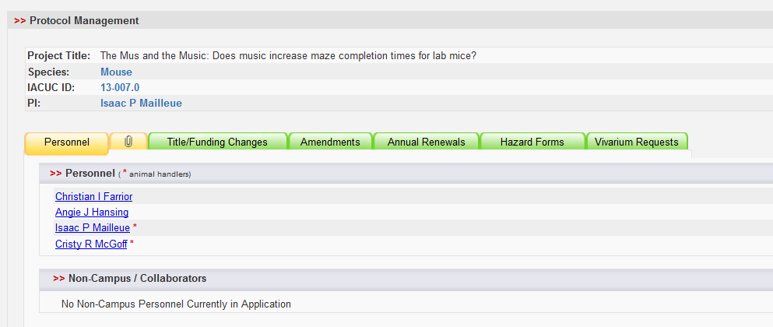
Now click on “Vivarium Requests”

Slide 8
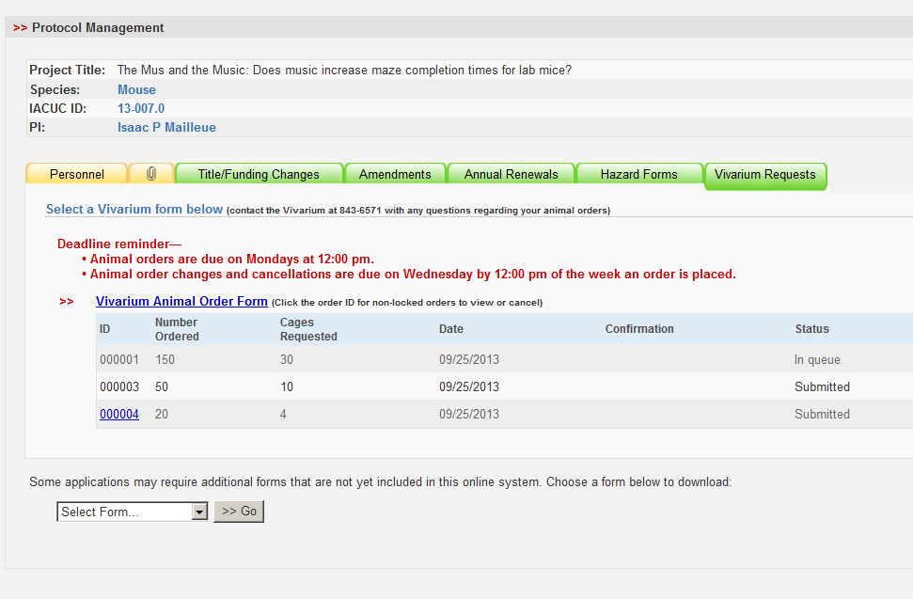
For a new order, click “Vivarium Animal Order Form”

Slide 9
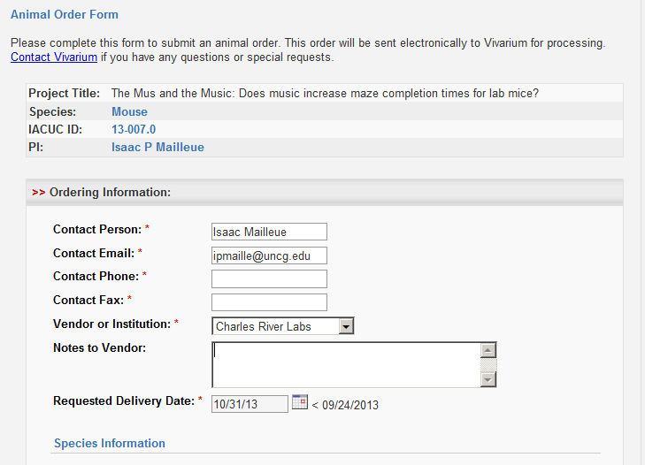
Fill out the order form, providing information for all fields with a * next to it.
When finished, click “Submit Order”

Slide 10
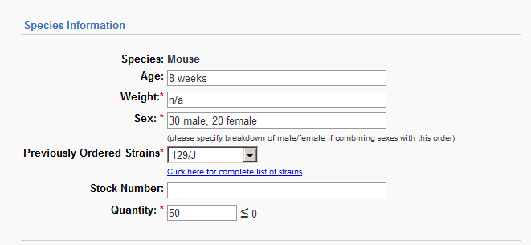
Enter the Species Information.
If a field (like weight) doesn’t matter to your study, type “N/A” in that field
Make sure you provide the number of males and females you want

Slide 11
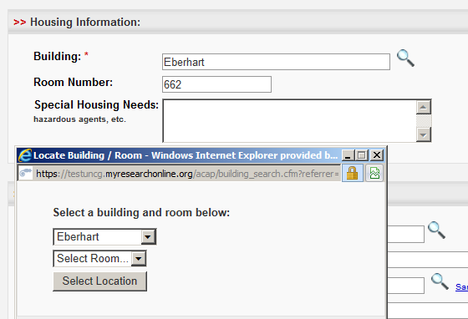
You will need to enter housing information when you order animals.
This information is only a request. There is no guarantee you will be able to house your animals in this space.

Slide 12
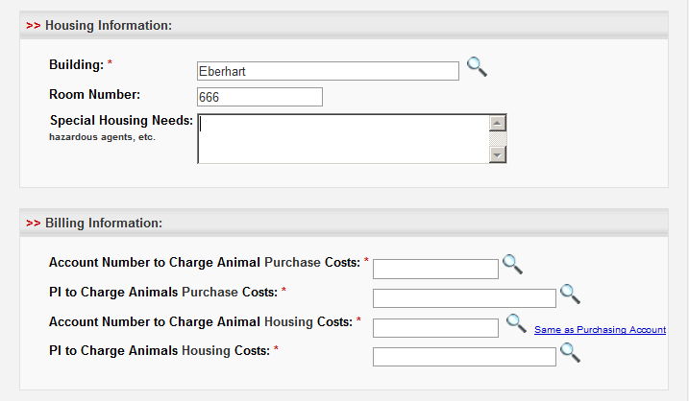
ACAP is currently being modified to reflect the way UNCG orders animals.
If you see the field “Account Number to Charge…”, realize the system wants to know how to pay for the ordered animals.
Please click on the magnifying glass to continue.

Slide 13
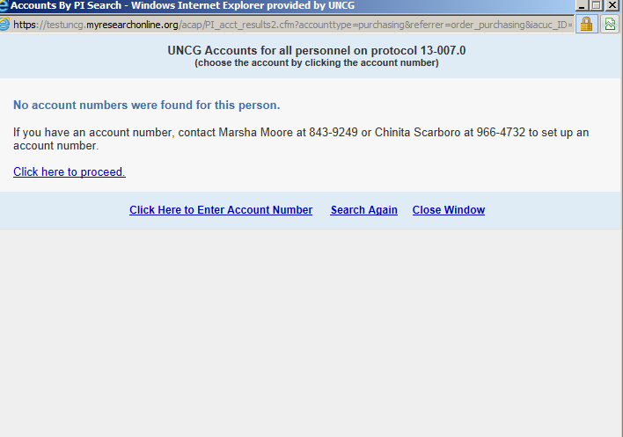
You will see this pop-up.
Click as indicated to enter your P Card information

Slide 14
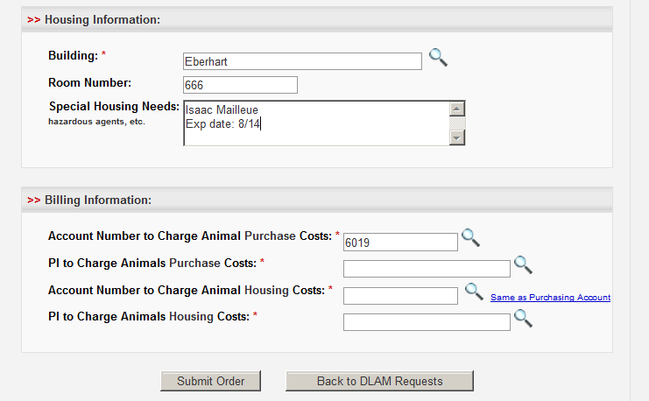
Enter the name and expiration date on your P Card under “Special Housing Needs”
Then select that same name from “PI to Charge Animals Purchase Costs”

Slide 15
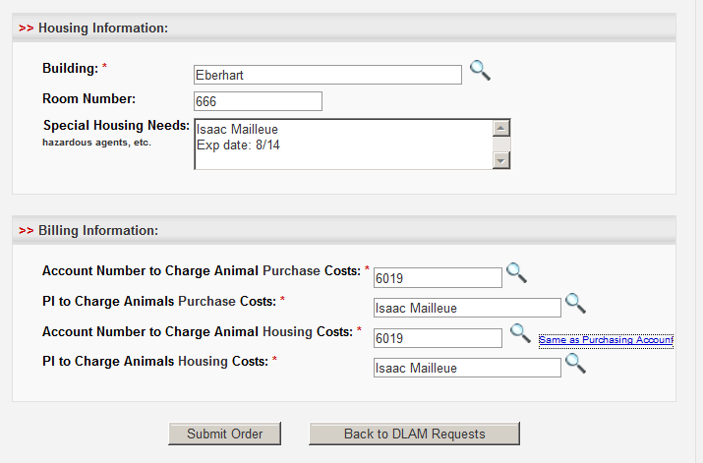
Now click “Same as Purchasing Account”
When finished, submit your order.

Slide 16
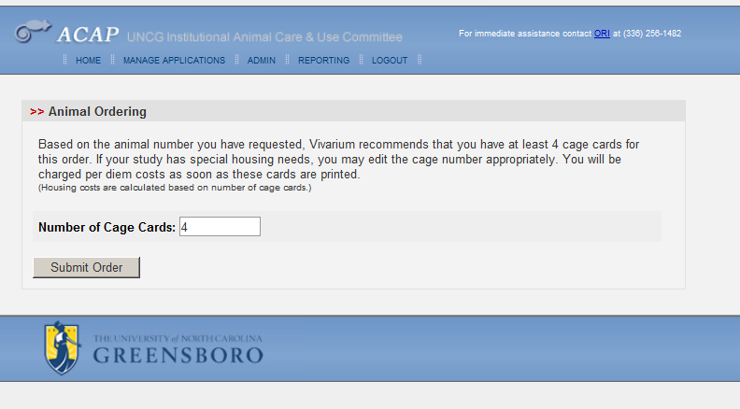
The “Number of Cage Cards” field is calculated automatically based on how many animals you have ordered. This number (animals per cage) will vary by species.
Mice will automatically have 5 placed per cage.
You can change the number of cages requested here if your study has different requirements.
When finished, click “Submit Order”

Slide 17
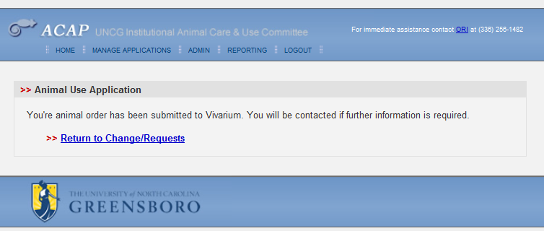
Your order should be processed soon.

Slide 18
Congratulations! You have ordered animals in ACAP!
The ORI staff will work to ensure your protocol is moved to the appropriate channels.
Please contact Isaac Mailleue at the ORI at 336-256-1482 with any questions or assistance you may require.
Continue to check in to ACAP for updates.

